Slide 1
Software Engineering (Design Concepts) _____________________________________________________
Feb 2013

Slide 2
Design Concepts
Design model depicts –
  S/w data structure
  Architecture
  Interfaces & components
Purpose
  To transform the requirements into a design of the “to-be” system
  Evolve a robust architecture for the system
  Adapt the design to match the implementation environment, designing it for performance
Notes:
Where customer requirements, Business rules and Technical considerations all come together. Design creates model or blue print of s/w. Design model depicts s/w data structure, architecture, interfaces & components that are necessary. (Analysis modeling provides required data, function, and behavior [thru Scenario based, flow-oriented, Class based & Behavioral modeling])

Slide 3
Design Concepts…..
Base of software engineering
  customer requirements, Business rules and Technical considerations all come together
Applied regardless of the process model
Encompasses
  Set of principles
  Concepts
  Practices
Leads to high quality product…..
Notes:
Where customer requirements, Business rules and Technical considerations all come together. Design creates model or blue print of s/w. Design model depicts s/w data structure, architecture, interfaces & components that are necessary. (Analysis modeling provides required data, function, and behavior [thru Scenario based, flow-oriented, Class based & Behavioral modeling])

Slide 4
Design Models
Data Design
  Transforming the analysis information model (data dictionary and ERD) into data structures
  Partially done with architecture design
Architectural Design
  Defines the relationship between major structural elements
  To achieve defined requirements, Constraints
  Framework of the final system
  Derived from Sys. Specs., Analysis Model, DFD
Notes:
Data design – created by transforming the analysis information model (data dictionary and ERD) into data structures required to implement the software. Part of the data design may occur in conjunction with the design of software architecture. More detailed data design occurs as each software component is designed
Architectural design - defines the relationships among the major structural elements of the software, the “design patterns” than can be used to achieve the requirements that have been defined for the system, and the constraints that affect the way in which the architectural patterns can be applied. It is derived from the system specification, the analysis model, and the subsystem interactions defined in the analysis model (DFD).

Slide 5
Design Models…..
Interface Design
  Describes how the software elements communicate with each other, with other systems, and with users
  Data flow and control flow diagrams provide information
Component Level Design
  Transformation of structural elements into procedural descriptions
  Derived from Process Specs., Control Specs & STD
Collectively form the design model, which is represented diagrammatically as a pyramid structure
Notes:
Interface design - describes how the software elements communicate with each other, with other systems, and with human users; the data flow and control flow diagrams provide much of the necessary information required.
Component-level design - created by transforming the structural elements defined by the software architecture into procedural descriptions of software components using information obtained from the process specification (PSPEC), control specification (CSPEC), and state transition diagram (STD).
Deployment - level design
Indicates how software functionality and subsystems will be allocated within the physical computing environment

Slide 6
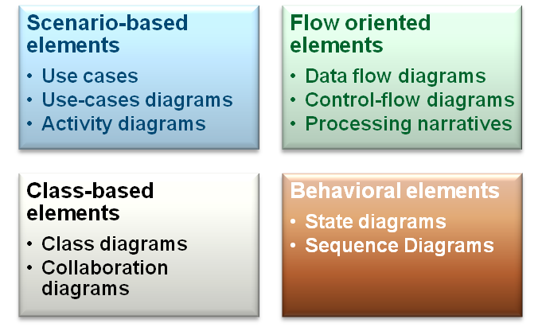
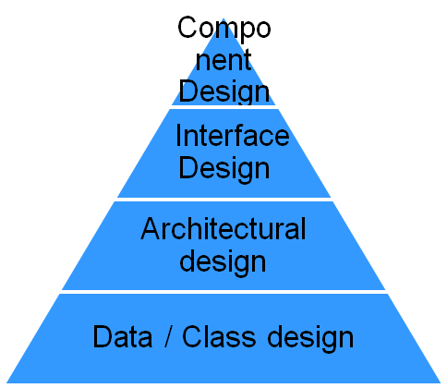
Design Concepts…..
Notes:
These models collectively form the design model, which is represented diagrammatically as a pyramid structure with data design at the base and component level design at the pinnacle. Note that each level produces its own documentation, which collectively form the design specifications document, along with the guidelines for testing individual modules and the integration of the entire package. Algorithm description and other relevant information may be included as an appendix.
Recall that software design can viewed as a process and a model. In general, the process be broken down into three broad stages:
Architectural design - specifications are analysed and the desired module structure is produced
Detailed design – each module is designed in detailed and specific algorithms and data structures are selected.
Design testing – this is an activity that must be continuously conducted in parallel with all software production activities.

Slide 7
Design Model Guidelines
Exhibit good architectural structure
Modularity
Contain distinct representations of data, architecture, interfaces, and components (modules)
Should lead to class implementation
Should lead to interfaces that reduces the complexity of connection (components & external environment)
Iterative
Common notation
Notes:
Recognizable style or pattern / Composed of components that exhibits good design characteristics / Implementable in evolutionary fashion
Modular (Should be logically partitioned )
Design should lead to data structure that are appropriate to classes to be implemented

Slide 8
Design Concepts: Fundamentals
Abstractions
  Allows designers to focus on solving a problem without being concerned about irrelevant lower level details
    Procedural abstraction – sequence of instructions/events
    Data abstraction - Named collection of data objects
Patterns
  Design structure that solves a particular problem within a specific context
  Can be reused for similar functionality
Modularity
  Ability to understand the software by examining its components independently
Notes:
Abstraction - allows designers to focus on solving a problem without being concerned about irrelevant lower level details (procedural abstraction - named sequence of events, data abstraction - named collection of data objects)

Slide 9
Design Concepts: Fundamentals…..
Control hierarchy (Program structure)
  Represents the module organization and implies a control hierarchy
  Does not represent the procedural aspects of the software
Structural Partitioning
  Horizontal partitioning
    Input
    Data Transformation
    Output
  Vertical partitioning (Factoring)
    Distributes control in a top-down manner

Slide 10
Design Concepts: Fundamentals…..
Data Structure
  Representation of the logical relationship among individual data elements
Software Procedures
  precise specification of processing
    Event Sequence
    Decision points
    Repetitive operations
Information Hiding
  Information (data and procedure) contained within a module is inaccessible to modules that have no need for such information

Slide 11
Design Concepts: Fundamentals…..
Architecture
  Structure / Organization of components
  Interaction between these components
  Data and its structure as used by the components
  Structured models – represent architecture as an organized collection of program components
  Framework models – increase level of abstraction by identifying repeatable code components
  Dynamic models – behavioral aspects – configuration changes
  Functional models – functional hierarchy

Slide 12
Design Classes
User Interface Classes
  Define all abstractions that are necessary for human-computer interaction
Business Domain Classes
  Refinements of classes defined earlier
Process Classes
  Implement lower-level business abstractions required to fully manage the business domain
Persistent Classes
  represent data stores that will persist even after execution of the software; e.g. Database
System Classes
  Implement software management and control functions that enable the system to operate and communicate within its computing environment and with the outside world

Slide 13
Design Classes…..
Characteristics of Design Classes
  Complete and sufficient : all methods and attributes
  Primitiveness : methods should give one service for the class, there should be no other way of implementing that method
  High cohesion : focused set of responsibilities dealing with the attributes of that class
  Low coupling : minimum collaboration between classes (not too much of information exchange between classes)

Slide 14
Universal 3 Tier Architecture
Presentation Layer
Business Layer
Database Layer
Browsers
Transactions / Business Logic
Databases
User interfaces
Other Systems

Slide 15
Implementation
Construction Phase
  Focus on detailed design, implementation, and testing to flesh out a complete system
  Focus on developing high-quality code cost-effectively
  Minimize development costs and achieve some degree of parallelism
  Iteratively develop a complete product that is ready to transition to its user community
  Organizing around the architecture prevents people from stepping on each other's toes

Slide 16
Q & A
Any Question?

